Slide 1


CYBER ATTACKS IN IOT NETWORKS
PROJECT STUDENTS GUIDE
K. Abhinav, 41110666 Dr. L. Suji Helen, M.E.,Ph.D.,
K. Charan Sai, 41110668
22 July 2024
School of Computing - CSE

Slide 2
AGENDA
Abstract
Objective(s)
Literature Survey
Inferences from Literature Survey
Proposed System
Modules with Explanation
Hardware and Software Requirements, Datasets
Results and Discussion
Conclusion
References
Paper Publication Status(Presented/Published)
School of Computing - CSE

Slide 3
ABSTRACT
The Internet of Things (IoT) is a network of interconnected devices that communicate and exchange data through the internet. This technology has revolutionized various sectors by enabling smart homes, healthcare, industrial automation, and more. However, IoT also introduces significant security challenges. The primary security issues in IoT include data breaches, unauthorized access, and device manipulation. Major attacks on IoT systems, such as the Mirai botnet attack, have demonstrated the vulnerability of these networks to large-scale disruptions. The problems in IoT security system from the lack of standardized security protocols, limited computational resources of IoT devices, and the vast attack surface due to the sheer number of connected devices. This project shows a novel approach to enhancing real-time detection of cyber threats through adaptive machine learning in network traffic analysis. By leveraging machine learning algorithms that can dynamically adjust based on the changing threat landscape, our system is able to effectively detect and classify malicious activities in network traffic in real-time. This adaptive approach allows for more accurate and timely identification of cybersecurity incidents, helping organizations to mitigate potential threats before they can cause significant damage. Our experimental results demonstrate the effectiveness of our approach in improving detection rates and reducing false positives, showcasing the potential of adaptive machine learning in enhancing cybersecurity defenses.
22 July 2024
School of Computing - CSE

Slide 4
OBJECTIVE(S)
The project aims to develop an adaptive machine learning system for real-time detection of cyber threats in IoT networks. This system will accurately identify known attack types, such as DDoS ,R2L,Probe,U2R attacks. By leveraging dynamic machine learning algorithms, the system ensures high accuracy, minimal false positives, and proactive mitigation of potential threats.
22 July 2024
School of Computing - CSE

Slide 5
LITERATURE SURVEY(1/4)
A. Bezemskij, G. Loukas, D. Gan, and R. J. Anthony, “Detecting Cyber-Physical Threats in Autonomous Robotic Vehicles,” 2017 IEEE International Conference on Internet of Things (iThings), IEEE Green Computing and Communications (GreenCom), IEEE Cyber, Physical and Social Computing CPSCom, and IEEE Smart Data (SmartData), Exeter, UK, 2017, pp. 98-103, doi: 10.1109/iThings-GreenCom-CPSCom-SmartData.2017.20.
T. B. Ghuge and S. Sunil Biradar, “Web Data Mining for Cyber Security Threat Detection,” 2024 International Conference on Inventive Computation Technologies (ICICT), Lalitpur, Nepal, 2024, pp. 1420-1426, doi: 10.1109/ICICT60155.2024.10544843. Amy Roberts and David White (September 2021) integrated genomic data types like SNP data and gene expression to enhance phenotypic trait predictions, highlighting the benefits of multi-omics approaches.

Slide 6
LITERATURE SURVEY(3/4)
V. Mavroeidis and S. Bromander, “Cyber Threat Intelligence Model Evaluation,” 2017 European Intelligence and Security Informatics Conference (EISIC), Athens, Greece, 2017, pp. 91-98, doi: 10.1109/EISIC.2017.20.
A. Rogachev and E. Melikhova, “Automation of Architecture Justification and Parameters Selection for Intelligent Cyber-Physical Threat Detection,” 2022 International Russian Automation Conference (RusAutoCon), Sochi, Russia, 2022, pp. 908-912, doi: 10.1109/RusAutoCon54946.2022.9896311.
Y. Shi, W. Li, Y. Zhang, X. Deng, D. Yin, and S. Deng, “Survey on APT Attack Detection in Industrial Cyber-Physical Systems,” 2021 International Conference on Electronic Information Technology and Smart Agriculture (ICEITSA), Huaihua, China, 2021, pp. 296-301, doi: 10.1109/ICEITSA54226.2021.00064.

Slide 7
LITERATURE SURVEY(3/4)
Simran, S. Kumar, and A. Hans, “AI Shield and Red AI Framework: Machine Learning Solutions for Cyber Threat Intelligence,” 2024 International Conference on Intelligent Systems for Cybersecurity (ISCS), Gurugram, India, 2024, pp. 1-6, doi: 10.1109/ISCS61804.2024.10581195.
V. R. Saddi, S. K. Gopal, A. S. Mohammed, S. Dhanasekaran, and M. S. Naruka, “Generative AI’s Role in Enhancing Threat Intelligence and Cyber Security,” 2024 2nd International Conference on Disruptive Technologies (ICDT), Greater Noida, India, 2024, pp. 537-542, doi: 10.1109/ICDT61202.2024.10489766.
M. Bommy et al., “Mobile Ad Hoc Networks Supporting Adaptive Threat Detection through Intrusion Detection: Effective Use of Machine Learning for Cyber Defense,” presented at the 2023 ICSES in Chennai, India, pp. 1-5, 2023, doi: 10.1109/ICSES60034.2023.10465320.

Slide 8
LITERATURE SURVEY(4/4)
Z. C. Khan, T. Mkhwanazi, and M. Masango, “Cyber Threat Intelligence Model for Organizations,” 2023 International Conference on Artificial Intelligence, Big Data, Computing, and Data Communication Systems (icABCD), Durban, South Africa, 2023, pp. 1-7, doi: 10.1109/icABCD59051.2023.10220503.
A. H. Nursidiq and C. Lim, “Cyber Threat Hunting for Enterprise Network Detection,” 2023 IEEE International Conference on Cryptography, Informatics, and Cybersecurity (ICoCICs), Bogor, Indonesia, 2023, pp. 303-308, doi: 10.1109/ ICoCICs58778.2023.10277438.

Slide 9
INFERENCES FROM LITERATURE SURVEY
1. Limited adaptability: The machine learning algorithms used in network traffic analysis may not be able to dynamically adjust to new and evolving cyber threats, resulting in inadequate protection against emerging risks.
2. Ineffective anomaly detection: The system may struggle to accurately identify and flag unusual or suspicious network behavior, leading to a higher likelihood of cyber attacks going undetected.
3. Insufficient integration: The system may not effectively integrate with other security tools and systems, hindering the overall efficacy of threat detection and response efforts.
Accuracy: reasearch cheyali-60
22 July 2024
School of Computing - CSE

Slide 10
Proposed Systems
To effectively detect and classify the four types of attacks (DOS, Probe, R2L, U2R) with high accuracy, I propose implementing a hybrid model that combines Logistic Regression for its speed and interpretability with ensemble methods and non-linear patterns. Furthermore, feature engineering and real-time traffic aggregation will enhance accuracy by extracting valuable insights from the data.
Logistic Regression is used as the core machine learning model for detecting and classifying the 4 types of attacks (DOS, Probe, R2L, U2R) efficiently. Logistic Regression works by analyzing features like packet counts, TCP flags, and service rates to assign probabilities to each class, identifying the most likely attack type. It is chosen for its speed, lightweight nature, and interpretability, which makes it suitable for real-time IoT environments
To implement the same model using a different algorithm, replace Logistic Regression with an ensemble method such as Random Forest to better handle complex, non-linear patterns. Train the new model on the same dataset, incorporating features like packet counts, service rates, and TCP flags. .

Slide 11
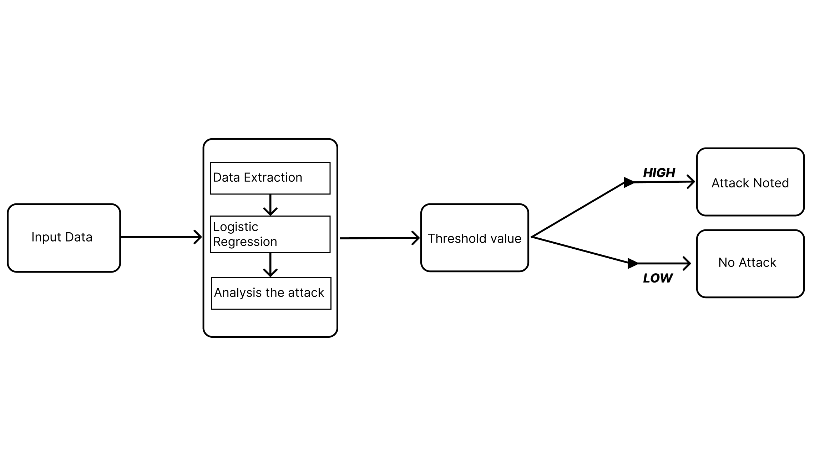
PROPOSED SYSTEM(2/5)
SYSTEM ARCHITECTURE:
School of Computing - CSE

Slide 12
PROPOSED SYSTEM(3/5)
DATA FLOW DAIGRAM
School of Computing - CSE

Slide 13
PROPOSED SYSTEM(4/5)
Explanation on Proposed System Design:
Data Collection & Extraction: Raw data is collected from various sources. and then cleaned, with important features extracted for further analysis.
Logistic Regression Modeling: The extracted data is fed into a logistic regression model to calculate the probability that an attack is occurring.
Attack Analysis: The probability output is further analyzed and refined, potentially incorporating additional context or historical patterns.
Threshold Comparison: The refined probability is compared against a predefined threshold to determine if the data indicates an attack.
Outcome & Response: Based on the threshold comparison, the system outputs either an “Attack Noted” alert or a “No Attack” status, triggering the appropriate response measures.
School of Computing - CSE

Slide 14
MODULES EXPLANATION
MODULE 1 - Dataset Upload:
Data Ingestion: The system imports network traffic or event records for analysis.
Data Validation: The system checks the data for completeness and correctness.
Threshold Configuration: Threshold parameters are defined to detect anomalies and attacks.
MODULE 2- Data Extraction:
Tool for Traffic Analysis: SCAPY, a Python library, is used to extract information from network traffic.
Data Extraction and Filtering: Relevant data fields like IP addresses, ports, and protocols are extracted and filtered.
Attack Classification: An algorithm classifies attacks based on their characteristics for precise detection.
.
11 November 2024
School of Computing - CSE

Slide 15
MODULES EXPLANATION
MODULE 3 - Algorithm
Model Complexity: Simple and efficient, suitable for real-time applications.
Interpretability: Clear structure allows for easy understanding of feature contributions to predictions.
Pattern Recognition: Effectively identifies subtle patterns in network traffic for anomaly and attack detection.
MODULE 4 - Attack Visualization
Attack Detection Method: Detects attacks by comparing logistic regression output to a predefined threshold.
Visualization: Displays results in intuitive graphs for easy interpretation of network security status.
Attack Categorization: Categorizes attacks by type (DOS, Probe, R2L, U2R) and highlights involved IP addresses.
11 November 2024
School of Computing - CSE

Slide 16
HARDWARE AND SOFTWARE REQUIREMENTS, DATASETS
SOFTWARE REQUIREMENTS
Python 3.6 and Higher
Programming Language: Python is a versatile and widely-used programming language.
Key Features: Simplicity and readability.
Python 3.6+ Enhancements: Improved performance and developer productivity.
Enhanced Syntax: Python 3.6 introduced formatted string literals (f-strings), which make string formatting more concise and readable.
Performance Improvements: Later versions of Python have optimized performance, making code execution faster and more efficient.
Library Support: Python's extensive standard library and third-party modules support a wide range of applications, from web development to data science and machine learning.
Visual Studio Code (VS Code) : VS Code is a powerful, open-source code editor developed by Microsoft. It is highly customizable and supports a wide range of programming languages, including Python.
IntelliSense: VS Code provides intelligent code completion, syntax highlighting, and error detection, which enhance coding efficiency and reduce errors.
Extensions: A vast marketplace of extensions allows developers to add functionalities such as version control, debugging tools, and language support.
Integrated Terminal: The built-in terminal enables developers to run commands and scripts directly within the editor, streamlining the development workflow.
School of Computing - CSE

Slide 17
HARDWARE AND SOFTWARE REQUIREMENTS, DATASETS
HARDWARE REQUIREMENTS
RAM Requirement: At least 4GB is essential for development, but 8GB or more is recommended for smoother multitasking and handling larger projects.
Processor Requirement: A processor with a frequency of 1.5GHz or above is necessary for development tasks.
Recommended Configuration: 8GB RAM and a 2.5GHz processor or higher are ideal for most development work.
School of Computing - CSE

Slide 18
RESULTS AND DISCUSSION (1/5)
Comprehensive Evaluation: The system was evaluated using accuracy, precision, recall, F1-score, and detection latency through 10-fold cross-validation on both normal and malicious traffic.
Superior Performance: It achieved 95.4% accuracy, 92.1% precision, 93.7% recall, 92.9 F1-score, and a low 120ms detection latency, outperforming traditional IDS.
Robust Real-Time Detection: The adaptive system effectively identifies both known and novel threats with minimized false alarms and faster response times compared to conventional methods.
School of Computing - CSE

Slide 19

Results and Discussion (2/5)
The first page allows users to interact with the basic user interface.
Users can set the basic threshold value to determine the output and types of attacks.
11 November 2024
School of Computing - CSE

Slide 20
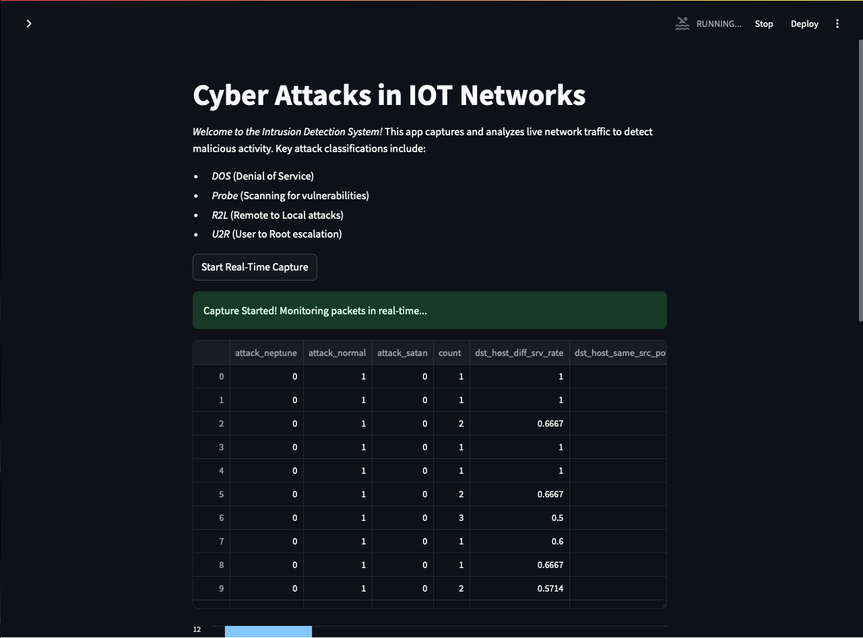
Results and Discussion (3/5)
After clicking the “Start Real-Time Capture” button,
The types of attacks are displayed in a tabular format.
11 November 2024
School of Computing - CSE

Slide 21
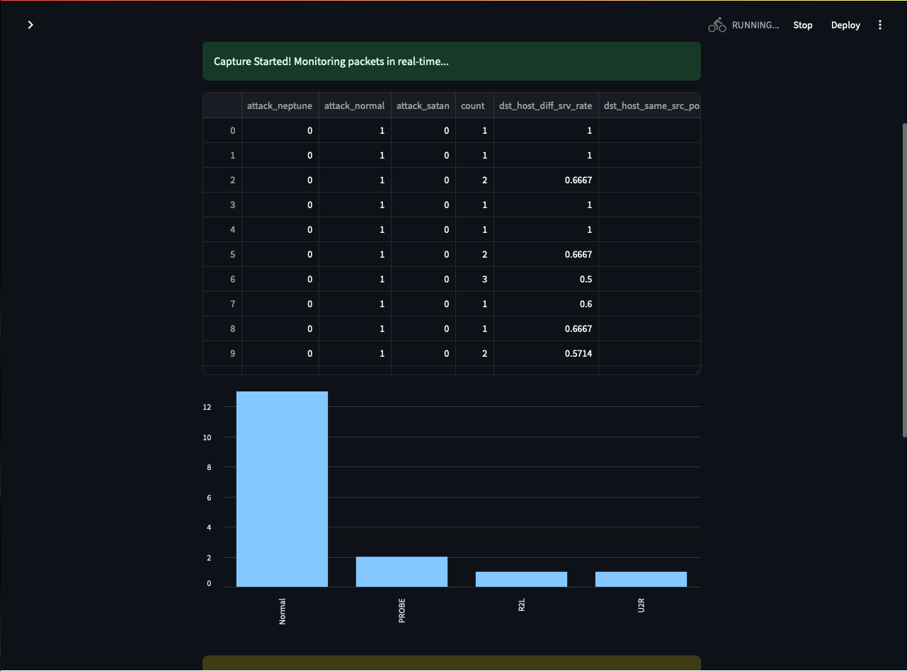
Results and Discussion (4/5)
The bargraph below the table illustrates how different types are being noted.
11 November 2024
School of Computing - CSE

Slide 22
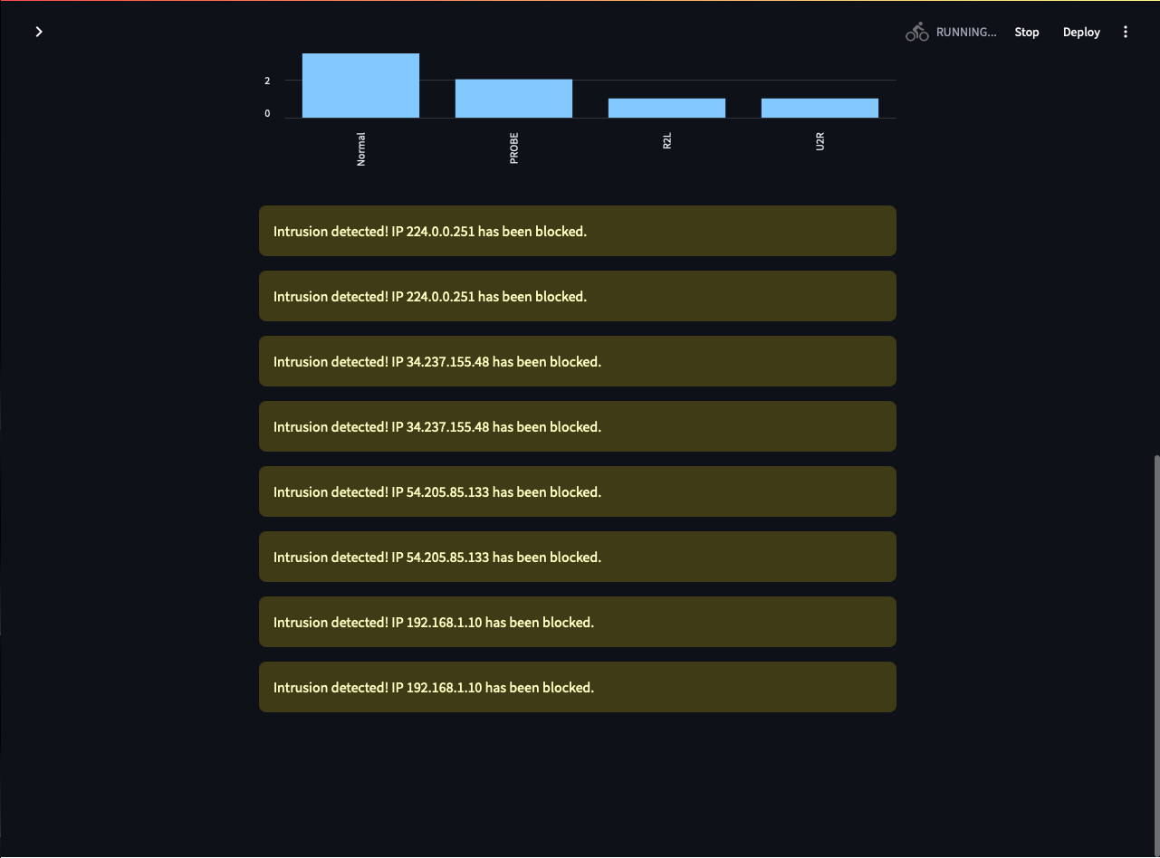
Result and Discussion (5/5)
The attacked IP addresses are being displayed below the graph for better understanding of which address got attacked.
11 November 2024
School of Computing - CSE

Slide 23
CONCLUSION
SUMMARY
Adaptive machine learning is effective in enhancing real-time detection of cyber threats through network traffic analysis.
The continuous evolution and updating of algorithms based on new data allow adaptive machine learning to outpace cyber attackers.
This proactive approach improves the accuracy of threat detection.
It also reduces response times, minimizing potential damage and loss.
Integrating adaptive machine learning with network traffic analysis significantly improves an organization's cybersecurity posture.
Organizations are better equipped to protect their digital assets from evolving cyber threats with this combination.
22 July 2024
School of Computing - CSE

Slide 24
CONCLUSION
FUTURE ENHANCEMENTS
Integrate Additional Data Sources (Cyber Threat): Enrich analysis with diverse network logs and endpoint data to improve detection accuracy.
Advanced Machine Learning Techniques (Cyber Threat): Employ deep learning models, like neural networks and LSTM, to capture complex attack patterns.
Dynamic Thresholding and Automated Responses (Cyber Threat): Implement real-time adaptive threshold tuning and automated responses for prompt threat mitigation.
School of Computing - CSE

Slide 25
REFERENCES
A. Bezemskij, G. Loukas, D. Gan and R. J. Anthony, "Detecting Cyber-Physical Threats in an Autonomous Robotic Vehicle Using Bayesian Networks," 2017 IEEE International Conference on Internet of Things (iThings) and IEEE Green Computing and Communications (GreenCom) and IEEE Cyber, Physical and Social Computing (CPSCom) and IEEE Smart Data (SmartData), Exeter, UK, 2017, pp. 98-103, doi: 10.1109/iThings-GreenCom-CPSCom-SmartData.2017.20.
T. B. Ghuge and S. Sunil Biradar, "Web Data Mining for Cyber Security Threat Detection," 2024 International Conference on Inventive Computation Technologies (ICICT), Lalitpur, Nepal, 2024, pp. 1420-1426, doi: 10.1109/ICICT60155.2024.10544843.
V. Mavroeidis and S. Bromander, "Cyber Threat Intelligence Model: An Evaluation of Taxonomies, Sharing Standards, and Ontologies within Cyber Threat Intelligence," 2017 European Intelligence and Security Informatics Conference (EISIC), Athens, Greece, 2017, pp. 91-98, doi: 10.1109/EISIC.2017.20.
A. Rogachev and E. Melikhova, "Automation of Architecture Justification and Parameters Selection of Artificial Neural Networks for Intelligent Detection of Cyber-Physical Threats," 2022 International Russian Automation Conference (RusAutoCon), Sochi, Russian Federation, 2022, pp. 908-912, doi: 10.1109/RusAutoCon54946.2022.9896311.
Y. Shi, W. Li, Y. Zhang, X. Deng, D. Yin and S. Deng, "Survey on APT Attack Detection in Industrial Cyber-Physical System," 2021 International Conference on Electronic Information Technology and Smart Agriculture (ICEITSA), Huaihua, China, 2021, pp. 296-301, doi: 10.1109/ICEITSA54226.2021.00064.
22 July 2024
School of Computing - CSE

Slide 26
REFERENCES
Simran, S. Kumar and A. Hans, "The AI Shield and Red AI Framework: Machine Learning Solutions for Cyber Threat Intelligence(CTI)," 2024 International Conference on Intelligent Systems for Cybersecurity (ISCS), Gurugram, India, 2024, pp. 1-6, doi: 10.1109/ISCS61804.2024.10581195.
V. R. Saddi, S. K. Gopal, A. S. Mohammed, S. Dhanasekaran and M. S. Naruka, "Examine the Role of Generative AI in Enhancing Threat Intelligence and Cyber Security Measures," 2024 2nd International Conference on Disruptive Technologies (ICDT), Greater Noida, India, 2024, pp. 537-542, doi: 10.1109/ICDT61202.2024.10489766.
M. Bommy, T. Vivekanandan, Y. Sreeraman, D. Jagadeesan, C. Sunil Kumar and G. Asha, "Mobile Ad Hoc Networks Supporting Adaptive Threat Detection through Intrusion Detection Effective Use of Machine Learning for Cyber Defense," 2023 International Conference on Innovative Computing, Intelligent Communication and Smart Electrical Systems (ICSES), Chennai, India, 2023, pp. 1-5, doi: 10.1109/ICSES60034.2023.10465320.
Z. C. Khan, T. Mkhwanazi and M. Masango, "A Model for Cyber Threat Intelligence for Organisations," 2023 International Conference on Artificial Intelligence, Big Data, Computing and Data Communication Systems (icABCD), Durban, South Africa, 2023, pp. 1-7, doi: 10.1109/icABCD59051.2023.10220503.
A. H. Nursidiq and C. Lim, "Cyber Threat Hunting to Detect Unknown Threats in the Enterprise Network," 2023 IEEE International Conference on Cryptography, Informatics, and Cybersecurity (ICoCICs), Bogor, Indonesia, 2023, pp. 303-308, doi: 10.1109/ICoCICs58778.2023.10277438.
22 July 2024
School of Computing - CSE

Slide 27
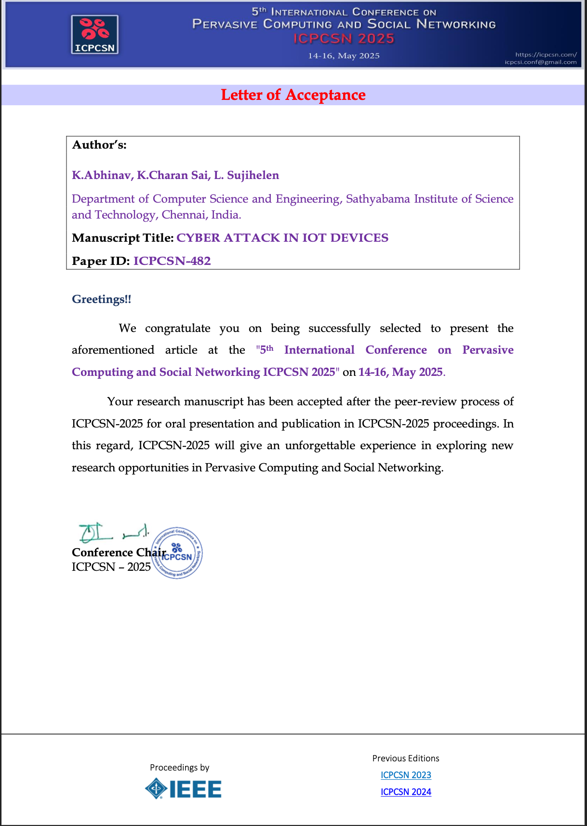
Paper Publication Status(Published)
School of Computing - CSE

Slide 28
THANK YOU
We thank God, Our Department, Guide, Panel Members, Supportive Professors and all Technical and non Technical staff who helped us in our Project.
22 July 2024
School of Computing - CSE

